Slide 1
Retro Classics: Pac-Man, Snake and Dot game
Done By Ashwin Prajeeth (2K19/CO/092), Asif Squad (2K19/CO/093), Binav Gautam (2K19/CO/103) & Gautam Kher (2K19/CO/140)

Slide 2
Contents
Modules used
Snake Game
Our Implementation of Snake
Output of our code
Pac-Man
Our Implementation of Pac-Man
Output of our code
Dot Game
Our Implementation of Dot Game
Output of our code

Slide 3
Modules used
Random : It generates pseudo-random numbers with various common distributions.
Turtle : This is essentially an educational framework for simple graphics applications. It is used to move the characters in the game.
Freegames : It is a collection of free Python games intended for education and fun. The games are written in simple Python code and designed for experimentation and changes. Simplified versions of several classic arcade games are included.
Time : This module provides various time-related functions.

Slide 4
Snake Game

Slide 5
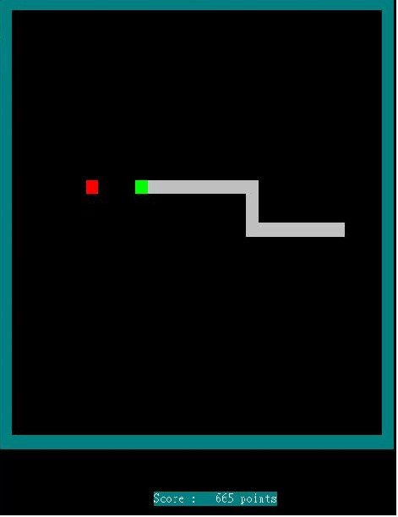
What is Snake Game?
Snake is the common name for a video game concept where the player maneuvers a line which grows in length as it eats a fruit.
The objective is to eat as many fruits as possible without hitting the head of the body on the snake.
We have implemented four different game modes with three different speed levels that can be selected by the user.

Slide 6
Our Implementation of Snake
In our implementation of the snake game, we have 4 modes:
Borders-free : The snake reappears on the opposite side of the screen once it goes out of the clipping window.
Borders : The game ends as you move out of the clipping window.
Walls and Border free : It has obstacles inside the window..
Walls and Borders: This is the hardest difficulty as there are both, obstacles and border along the window.

Slide 7
Our Implementation of Snake
In our implementation of the snake game, we have 3 speeds::
Slow : The snake moves in a relatively slower speeds which will make it easy for the user.
Medium : The snake moves twice as fast when compared to slow..
Fast : The snake moves the fastest.

Slide 8
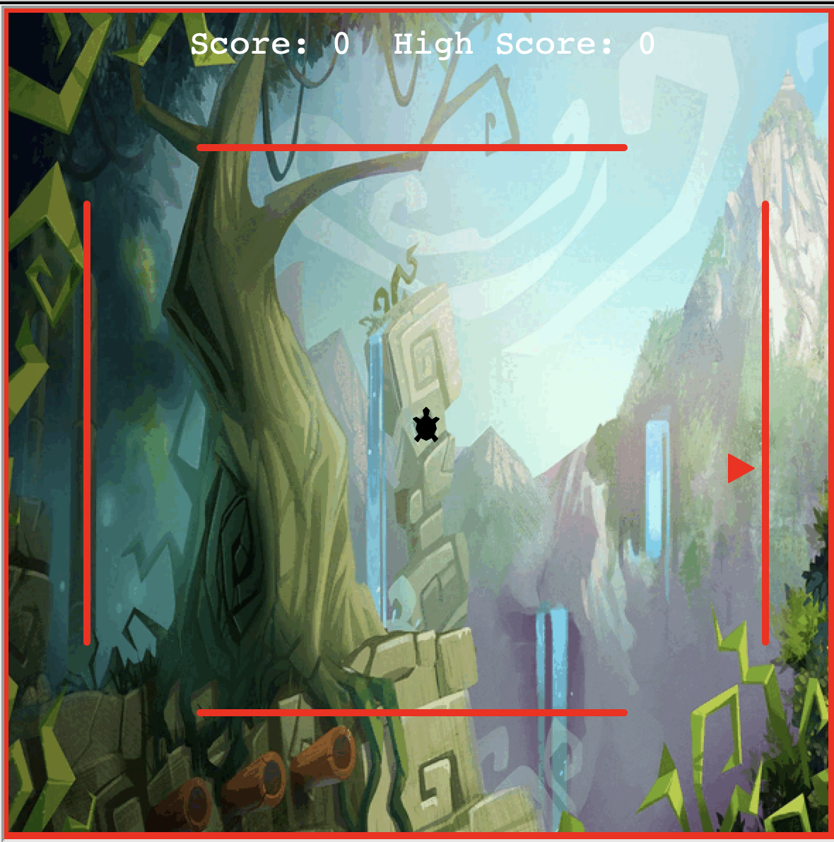
Output of our code:

Slide 9
Pac-Man

Slide 10
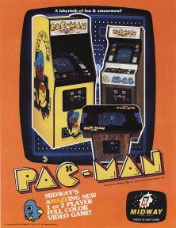
What is Pac-Man?
Pac-Man is an action maze chase video game; the player controls the eponymous character through an enclosed maze.
The objective of the game is to eat all of the dots placed in the maze while avoiding four ghosts.
When Pac Man eats all of the dots, or if Pac-Man makes contact with a ghost, the game ends.

Slide 11
Our Implementation of Pac-Man
def world() :
This function helps build the pac man world using the turtle module. The background and the path are created first, and then the pacman and ghosts are drawn.
Tiles are built according to 0 or 1 value of the tiles array, and a corresponding square is drawn at every position.
After tiles are created, pellets are placed in all tiles with value 1, which can be consumed by the pacman.

Slide 12
Implementation of Pac-Man
def move() :
This function controls the continuous movement of the pacman and the ghosts around the maze.
To make sure all moves are valid, a valid function is implemented that makes sure the position that pac man or a ghost is trying to change into is a valid block.
The pacman moves according to key clicks input by the user, while the movement of the ghosts is randomized.

Slide 13
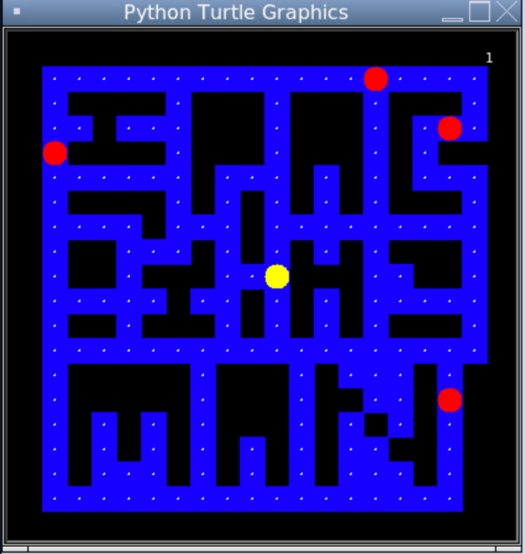
Output of our code:

Slide 14
Dot Game

Slide 15
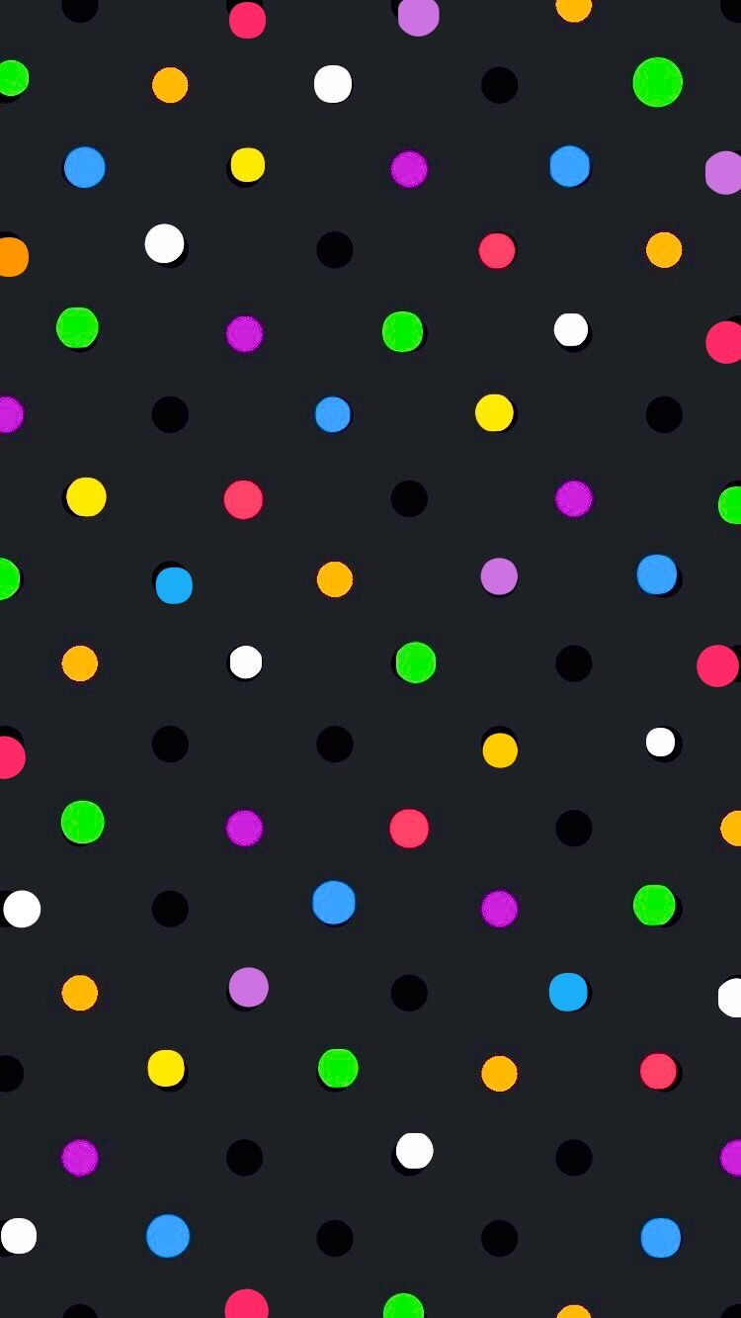
What is Dot Game?
Our rendition of the popular game flappy bird.
The objective is to avoid the balls that are floating in space.
If the dot hits any ball or go outside the clipping window, the game ends.
We have 3 difficulty modes with 3 different speed modes.

Slide 16
Our Implementation of Dot-Game
In our implementation of the snake game, we have 3 game difficulties:
Easy : There are relatively less balls blocking your way.
Medium : Balls in the clipping window increase.
Hard : Balls are very crowded and the game is very hard to play.

Slide 17
Our Implementation of Dot-Game
In our implementation of the snake game, we have 3 speeds:
Slow : The balls (obstacles) moves in a relatively slower speeds which will make it easy for the user.
Medium : The balls (obstacles) moves twice as fast when compared to slow..
Fast : The balls (obstacles) moves the fastest.

Slide 18
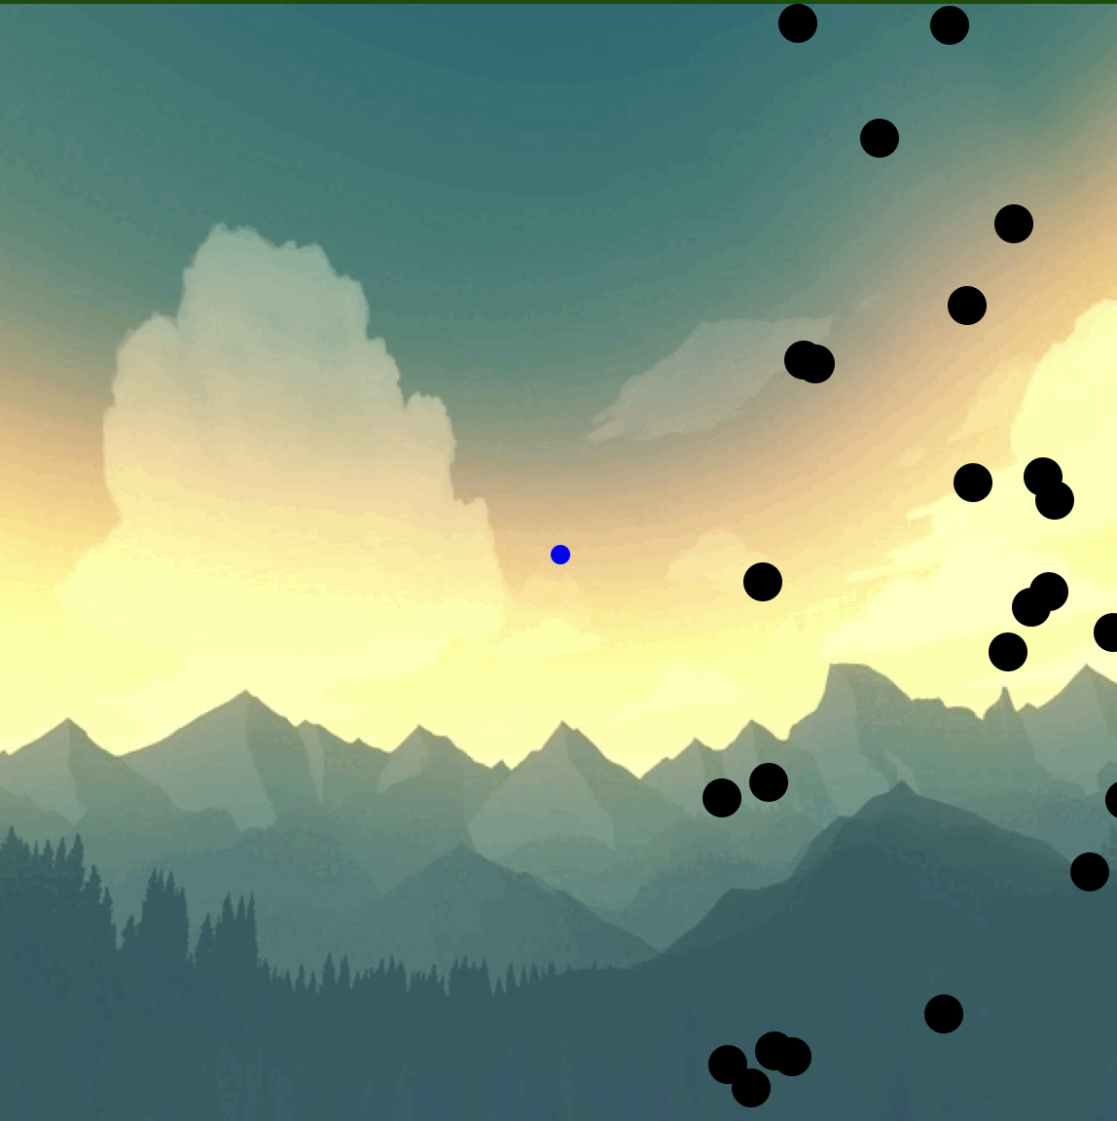
Output of our code:

Slide 19
THANK YOU

